Slide 1

POWER BI PRESENTATION ON DIABETES.
Today I inform you and know more about the diabetes through my presentation.
By using Power Bi tool and give the idea of the diabetes through the dashboard and research.
This is the presentation on the type 1 Diabeties.
PBRC 2006
<number> of 36

Slide 2
Type 1 Diabetes
*Overwiew
*Causes
*Insulin
*Cocerns and Safety

Slide 3
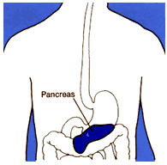
Types of Diabetes
Type 1 Diabetes mellitus (DM)
Type 2 Diabetes mellitus (DM)
Gestational Diabetes
PBRC 2009
<number> of 38

Slide 4

Type 1: Overview
Usually diagnosed in children and young adults.
Previously known as “juvenile diabetes”.
In this type of diabetes, the body does not produce insulin.
Insulin is required in order for the body to properly use sugar, in the form of glucose.
Sugar is the basic fuel for the cells in the body.
Insulin’s role is to take the sugar from the blood and carry it into cells where it can be used to provide energy for the body to work.
PBRC 2009
<number> of 38

Slide 5
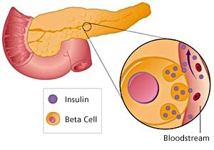
About Insulin
Insulin is a hormone made from beta cells inside of the pancreas.
With each meal consumed, beta cells release insulin in order to help the body use or store the blood glucose it gets from foods.
With Type 1 Diabetes; however, the pancreas no longer makes insulin.
These beta cells have been destroyed for some reason and insulin shots are thus required in order for the body to use the glucose coming from meals.
PBRC 2009
<number> of 38

Slide 6
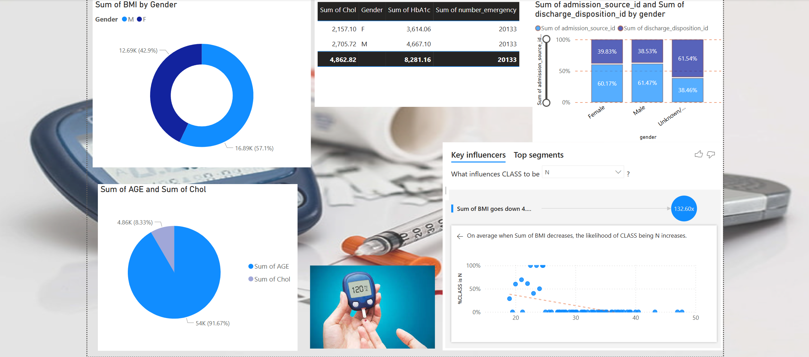
PBRC 2006
<number> of 36

Slide 7
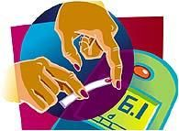
How to Know When Your Blood Sugar is Low?
Part of managing diabetes is to check your blood glucose often.
Ask your doctor how often you should check your blood sugar and what your levels should be.
Results from checking your level will indicate whether it is low or not.
It is important to follow your blood glucose monitoring schedule.
It is also important to check any time that you feel your blood sugar might be low and treat accordingly.
The basic rule is: “When in doubt, treat.”
PBRC 2009
<number> of 38

Slide 8

Importance of Monitoring Blood Glucose
For those with diabetes, keeping blood glucose levels as close to normal as possible is very important.
Keeping blood glucose in your target range can help prevent or delay the start of diabetes complications, such as:
  Nerve, eye, kidney, or blood vessel damage.
PBRC 2009
<number> of 36

Slide 9

Who Should Check?
Experts believe that anyone with diabetes can benefit from checking their blood glucose.
The American Diabetes Association recommends blood glucose checks if you have diabetes and are:
  Taking insulin or diabetes pills
  On intensive insulin therapy
  Pregnant
  Having a hard time controlling your blood glucose levels
  Having severe low blood glucose levels or ketones from
  high blood glucose levels
  Having low blood glucose levels without usual warning signs
PBRC 2009
<number> of 38

Slide 10
End of Slide and Presentation
Name-Lakshya Tyagi
Student Of Mr.Divakar sir at Ducat
~Thank You
PBRC 2006
<number> of 36

